Slide 1


SOFTWARE Design & Analysis (Week-15)
Usama Musharaf
MS-CS (Software Engineering)
Lecturer (Department of Computer Science)
FAST-NUCES Peshawar

Slide 2
Agenda of Week # 15
Structural Patterns
Adapter
Bridge
Composite
Decorator
Façade
Flyweight
Proxy

Slide 3
Adapter Design Pattern (structural pattern)

Slide 4
Adapter Design Pattern
Adapter is a structural design pattern that allows objects with incompatible interfaces to collaborate.

Slide 5
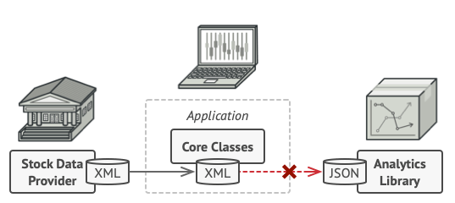
Adapter Design Pattern
Problem Statement:
Imagine that you’re creating a stock market monitoring app.
The app downloads the stock data from multiple sources in XML format and then displays nice-looking charts and diagrams for the user.
At some point, you decide to improve the app by integrating a smart 3rd-party analytics library.
But the analytics library only works with data in JSON format.
You can’t use the analytics library “as is” because it expects the data in a format that’s incompatible with your app.

Slide 6
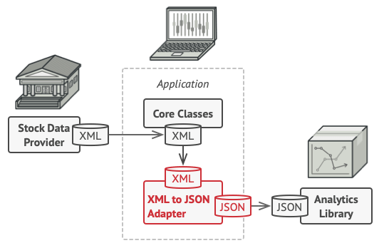
Adapter Design Pattern
Solution:
You can create an adapter. This is a special object that converts the interface of one object so that another object can understand it.
An adapter wraps one of the objects to hide the complexity of conversion happening behind the scenes.
The wrapped object isn’t even aware of the adapter. For example, you can wrap an object that operates in meters and kilometers with an adapter that converts all of the data to imperial units such as feet and miles.

Slide 7
Adapter Design Pattern
Adapters can not only convert data into various formats but can also help objects with different interfaces collaborate.
Here’s how it works:
The adapter gets an interface, compatible with one of the existing objects.
Using this interface, the existing object can safely call the adapter’s methods.
Upon receiving a call, the adapter passes the request to the second object, but in a format and order that the second object expects.

Slide 8
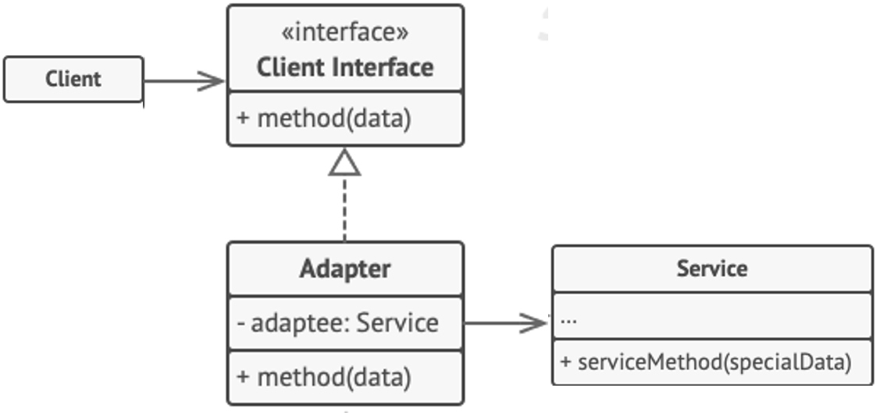
Adapter Design Pattern

Slide 9
Adapter Design Pattern
Business Card Designer
Customer
Employee
Employee Adapter Class

Slide 10
Lets Code

Slide 11
Bridge Design Pattern (structural pattern)

Slide 12
Bridge Design Pattern
Bridge is a structural design pattern that lets you split a large class or a set of closely related classes into two separate hierarchies
abstraction and implementation
which can be developed independently of each other.

Slide 13
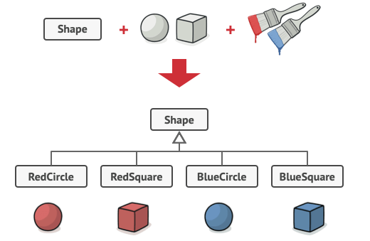
Bridge Design Pattern
Problem Statement:
Say you have a geometric Shape class with a pair of subclasses: Circle and Square.
You want to extend this class hierarchy to incorporate colors, so you plan to create Red and Blue shape subclasses.
However, since you already have two subclasses, you’ll need to create four class combinations such as BlueCircle and RedSquare.
Adding new shape types and colors to the hierarchy will grow it exponentially.
For example, to add a triangle shape you’d need to introduce two subclasses, one for each color.
And after that, adding a new color would require creating three subclasses, one for each shape type. The further we go, the worse it becomes.

Slide 14
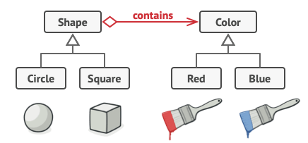
Bridge Design Pattern
Solution:
This problem occurs because we’re trying to extend the shape classes in two independent dimensions: by form and by color.
That’s a very common issue with class inheritance.
The Bridge pattern attempts to solve this problem by switching from inheritance to the object composition.
What this means is that you extract one of the dimensions into a separate class hierarchy, so that the original classes will reference an object of the new hierarchy, instead of having all of its state and behaviors within one class.

Slide 15
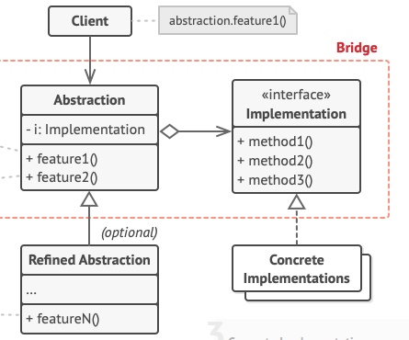
Bridge Design Pattern

Slide 16
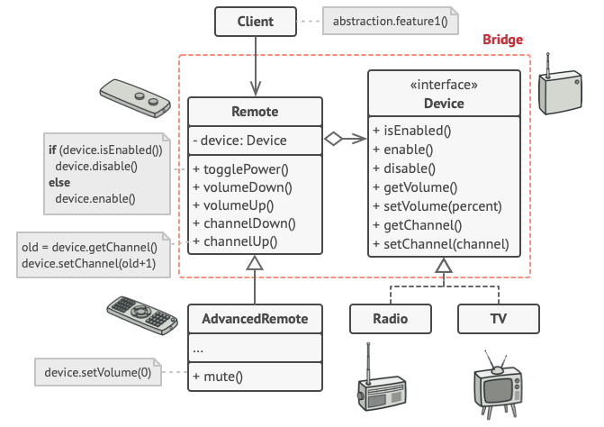
Bridge Design Pattern

Slide 17
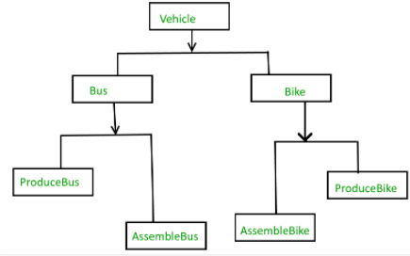
Without Bridge Design Pattern

Slide 18
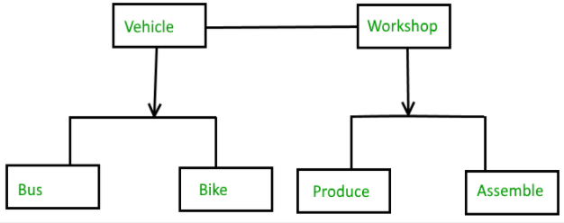
Bridge Design Pattern

Slide 19
Bridge Design Pattern
Example:
We have custom business logic to process employee data, and this processed employee data will be saved as an XML on a Windows machine and as a JSON file on a LINUX machine.
The saving part differs based on the operating system.
As per the Bridge Design Pattern, we may abstract (decouple) the business processing logic from the saving logic and it will have no knowledge of how the data will be saved.
The abstraction contains a reference (via composition) to the implementer.
The implementer class (saving of data) details will be provided during the runtime based on the operating system and both abstraction and implementer can be developed independently.

Slide 20
Decorator Design Pattern (structural pattern)

Slide 21
Decorator Design Pattern
Decorator is a structural design pattern that lets you attach new behaviors to objects by placing these objects inside special wrapper objects that contain the behaviors.
When we want to enhance the behavior of our existing objects dynamically.
Decorator wraps an object within self and provides same interface as the wrapped object, so the client of original object does not need to change.

Slide 22
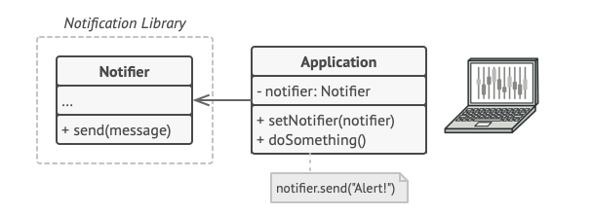
Decorator Design Pattern
Problem Statement:
Imagine that you’re working on a notification library which lets other programs notify their users about important events.
The initial version of the library was based on the Notifier class that had only a few fields, a constructor and a single send method.
The method could accept a message argument from a client and send the message to a list of emails that were passed to the notifier via its constructor.
A third-party app which acted as a client was supposed to create and configure the notifier object once, and then use it each time something important happened.

Slide 23
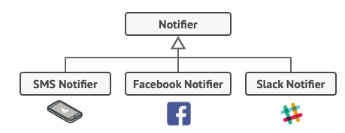
Decorator Design Pattern
Problem Statement:
At some point, you realize that users of the library expect more than just email notifications.
Many of them would like to receive an SMS about critical issues.
Others would like to be notified on Facebook and, of course, the corporate users would love to get Slack notifications.

Slide 24
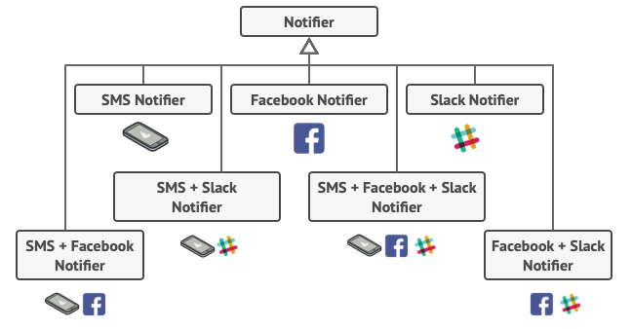
Decorator Design Pattern
Problem Statement:
Some of them would like to be informed through every channel.

Slide 25
Decorator Design Pattern
Solution:
Extending a class is the first thing that comes to mind when you need to alter an object’s behavior. However, inheritance has several serious caveats that you need to be aware of.
Inheritance is static. You can’t alter the behavior of an existing object at runtime. You can only replace the whole object with another one that’s created from a different subclass.
Composition is always preferred over inheritance.
We use a class named as decorator that wraps an object within self and provides same interface as the wrapped object, so the client of original object does not need to change.

Slide 26
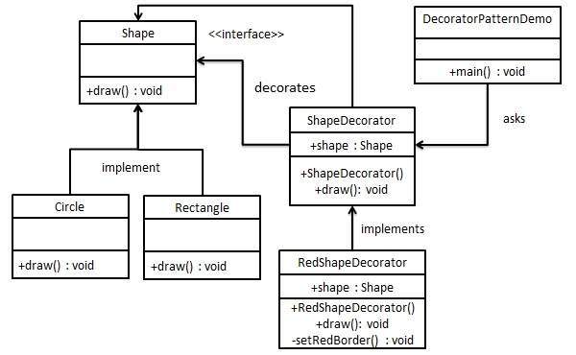
Decorator Design Pattern

Slide 27
Decorator Design Pattern
Shape:
public interface Shape {
void draw();
}
Rectangle:
public class Rectangle implements Shape {
@Override
public void draw() {
System.out.println("Shape: Rectangle");
}
}
Circle:
public class Circle implements Shape {
@Override
public void draw() {
System.out.println("Shape: Circle");
}
}
Decorator Shape
public abstract class ShapeDecorator implements Shape {
protected Shape decoratedShape;
public ShapeDecorator(Shape decoratedShape){
this.decoratedShape = decoratedShape;
}
public void draw(){
decoratedShape.draw();
}
}

Slide 28
Decorator Design Pattern
RedShape Decorator:
public class RedShapeDecorator extends ShapeDecorator {
public RedShapeDecorator(Shape decoratedShape) {
super(decoratedShape);
}
@Override
public void draw() {
decoratedShape.draw();
setRedBorder(decoratedShape);
}
private void setRedBorder(Shape decoratedShape){
System.out.println("Border Color: Red");
}
}
Main Class
public class DecoratorPatternDemo {
public static void main(String[] args) {
Shape circle = new Circle();
Shape redCircle = new RedShapeDecorator(new Circle());
Shape redRectangle = new RedShapeDecorator(new Rectangle());
System.out.println("Circle with normal border");
circle.draw();
System.out.println("\nCircle of red border");
redCircle.draw();
System.out.println("\nRectangle of red border");
redRectangle.draw();
}
}

Slide 29
Proxy Design Pattern (structural pattern)

Slide 30
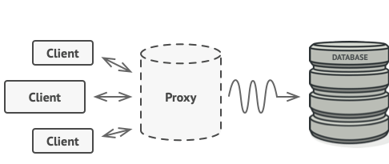
Proxy Design Pattern
Proxy is a structural design pattern that lets you provide a substitute or placeholder for another object.
A proxy controls access to the original object, allowing you to perform something either before or after the request gets through to the original object.

Slide 31
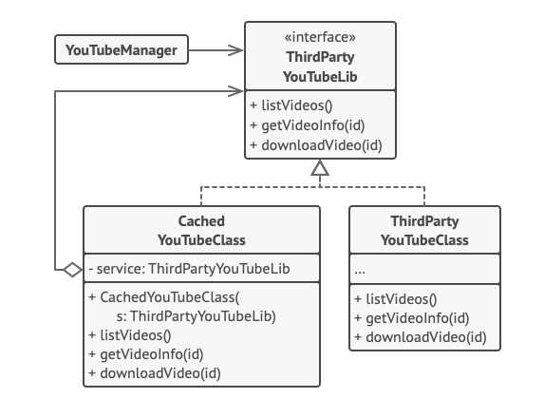
Proxy Design Pattern

Slide 32
HAVE A GOOD DAY!

